Slide 1
Egyptian Ratscrew Simulation Model
By: Joshua Medvinsky and Daniel Penkov

Slide 2
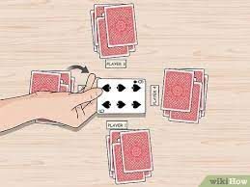
Simulation Preview
Basic Game Overview
Slap Rules
Face Card Rules
Player Skill Types
Reaction
Memorization
Placing
Misslaping
Input Knobs
Number of players
Number of decks
Game Rules
Player skill values

Slide 3
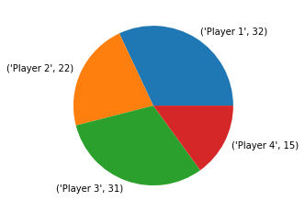
Model Validation/Verification
We will validate our model by checking if the win percentage of each player that is outputted from our model adds up to a hundred percent.
32%+22%+15%+31%=100%

Slide 4
Verification
We will verify our model by conducting a test of a single game, and using text output to check if every action in the game we simulate follows all the rules of Egyptian Ratscrew

Slide 5
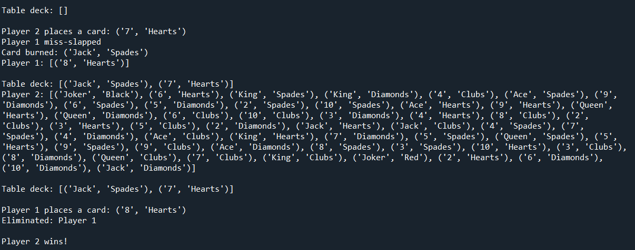
Verification

Slide 6
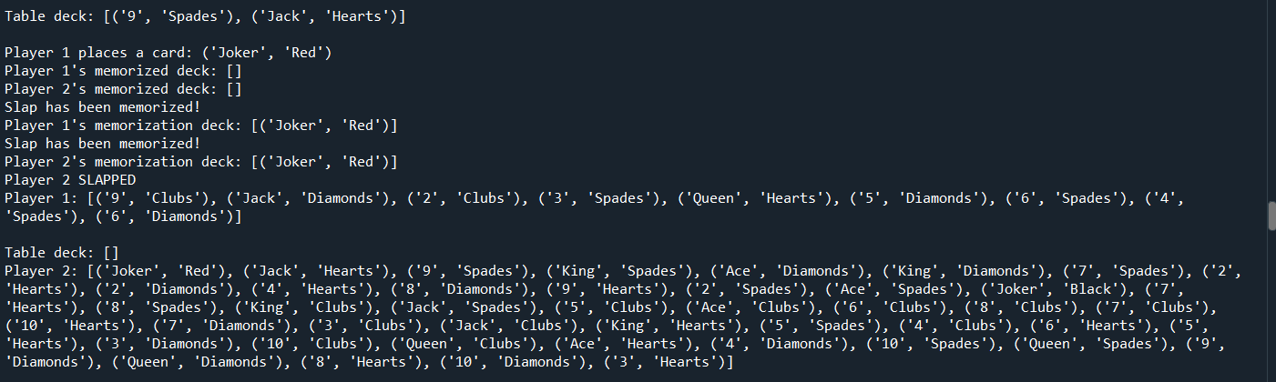
Verification

Slide 7
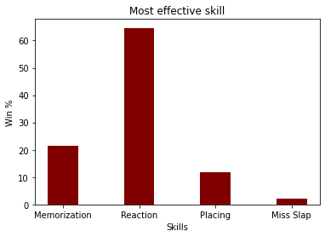
Analysis Question: Which player skill is most effective?

Slide 8
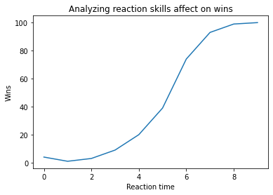
Analysis Question: How does a player’s reaction skill value affect their win favorability?

Slide 9
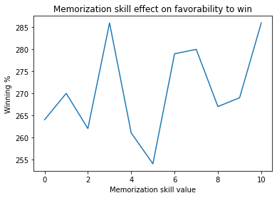
Analysis Question: How does a player’s memorization skill value affect their win favorability? (Daniel)
10000 simulations:
Winning % / 10

Slide 10
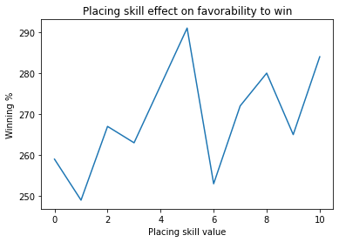
Analysis Question: How does a player’s placing skill value affect their win favorability? (Daniel)
10000 simulations:
Winning % / 10

Slide 11
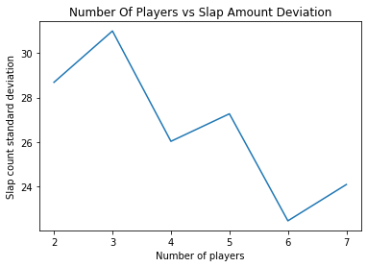
Analysis Question: How does the number of players in a game affect the deviation of slap counts? (Daniel)

Slide 12
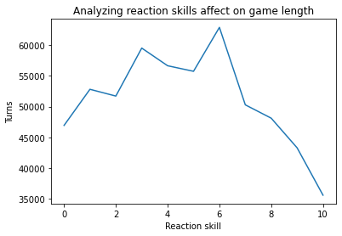
Analysis Question: How does a player’s reaction skill affect the length of the game? (Josh)

Slide 13
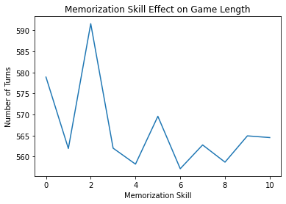
Analysis Question: How does a player’s memorization skill affect the length of the game? (Daniel)
10000 simulations:

Slide 14
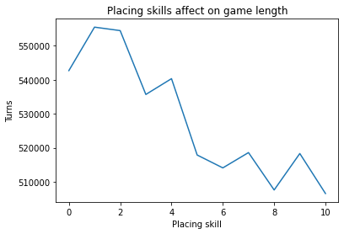
Analysis Question: How does a player’s placing skill affect the length of the game? (Josh)
10000 total simulations:

Slide 15
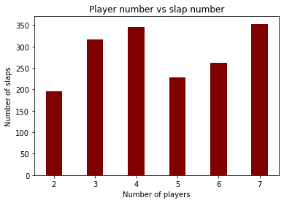
Analysis Question: How does the number of players in a game affect the number of slaps won? (Daniel)

Slide 16
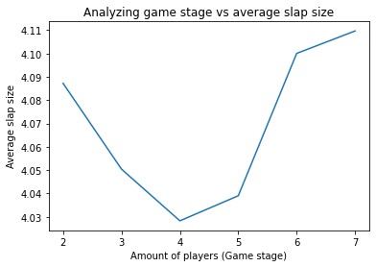
Analysis Question: How does the average slap size change in every stage of a game? (Josh)

Slide 17
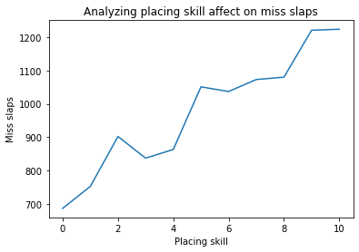
Analysis Question: How does a player’s placing skill affect the total number of miss slaps opponents cause in a game?

Slide 18
Conclusions

